Slide 1

Analyst marketing strategy
Project data analyst

Slide 2
Summary analyst
Analyst Overview
Introduction the shop coffee
Introduction dataset
Progress handle data
processed data overview
The Competition
Graph analysis
overview comment
LINK
Analysis link
Tableau link

Slide 3
Analyst Overview
Introducton the shop coffee
Introduction dataset
Progress handle data
Data overview

Slide 4

Introduction the shop coffee
The shop coffee is a chain of stores location in many different cities in the United States.
store in cities as: Chicago, Wheaton, Glen Ellyn, Hoffman Estates, St. Charles, Minooka, Inverness, Schaumburg, Algonquin, Warrenville, Batavia, Aurora, Streamwood, Oswego, Palatine, Romeoville, Elgin, Mokena, Plainfield, Carol Stream, Bolingbrook, Willowbrook, Barrington, West Chicago, Naperville, Deer Park, West Dundee

Slide 5
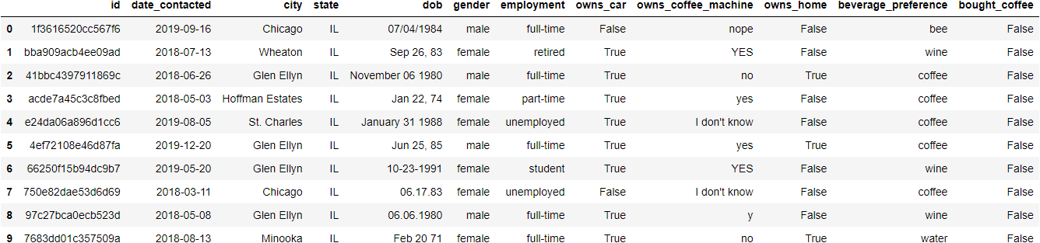
Introduction dataset
Basic marketing data for a small coffee shop chain showing potential customers that were contacted via a marketing campaign and whether or not they made a coffee purchase.
the dataset is collect from website Kaggle THE SHOP COFFEE .

Slide 6

Introduction dataset
ID: Unique customer ID.
date_contacted: The date the potential customer was contacted.
City: The city where the potential customer lives.
State: The state where the potential customer lives
Dob: The potential customer's date of birth.
Gender: The potential customer's gender.
Employment: The potential customer's employment status.
Owns_car: Wheter or not the potential customer owns a car.
Owns_coffee_machine: Whether or not the potential customer owns a coffee machine.
Owns_home: Whether or not the potential customer own a home.
Bought_coffee: Whether or not customers buy coffee at the shop.

Slide 7
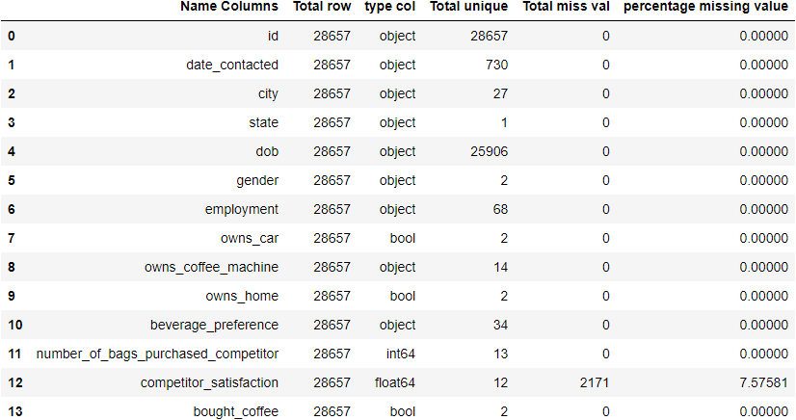
Summary overview dataset

Slide 8
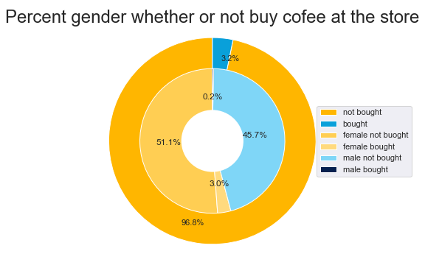
Graph analysis
96.8%
3.2%
Sum customer whether or buy 100% and customers does not buy coffee is near 97%
Sum customer whether or buy 100% and customers does buy coffee is near 3.2%
64.1%
91%
Sum customer whether or buy 100% and customers female is near 64.1%
Sum customer whether or buy 100% and customers female is near 45.9%
Comment:
We can see that the marketing campaign not successful.
The ratio between buying coffee by gender is the same.

Slide 9
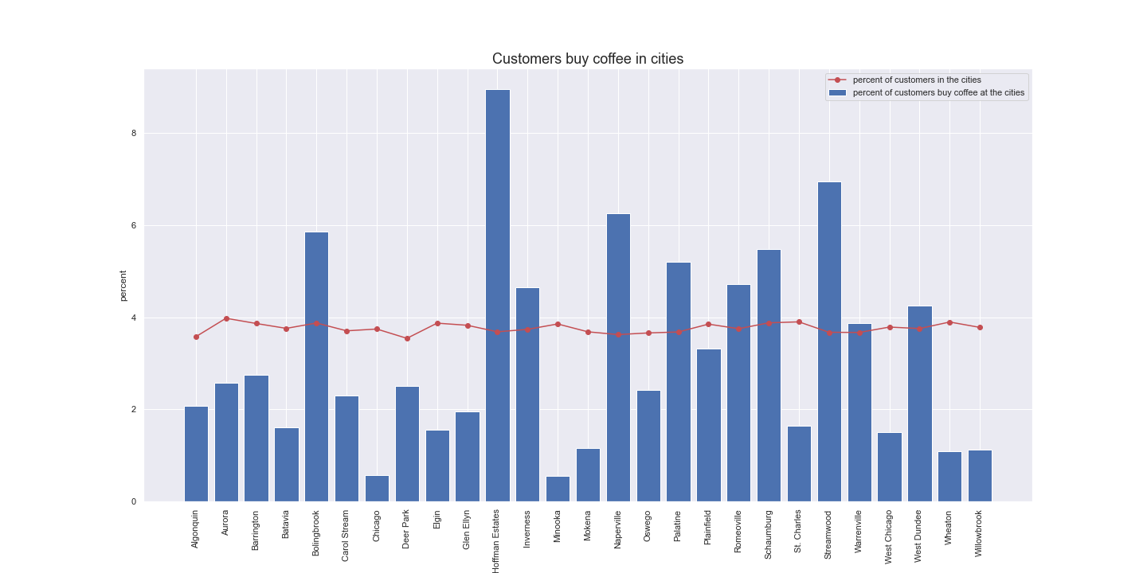
COMMENT
Consumers distribution is the same between cities.
Percent consumers buy coffee at the shop is very small. About 3,76% of consumers buy coffee at shops in all the cities.
These are cities that have the percent consumers who buy coffee most Hoffman Estates 8.95%, Naperville, 6.26%, Streamwood 6.95%.

Slide 10
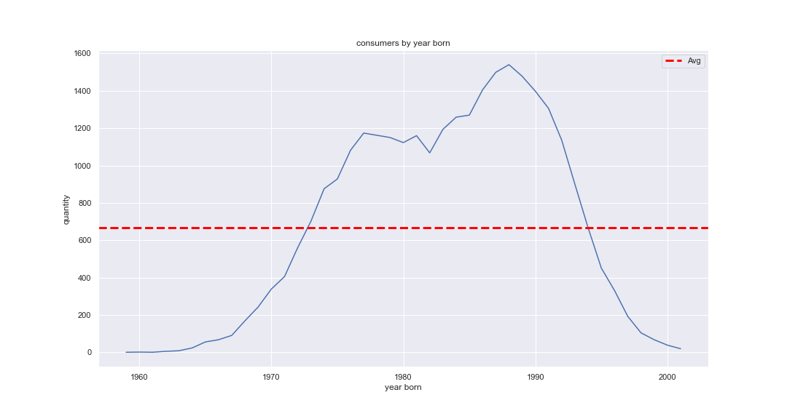
COMMENT:
Quantity consumer distribution very widely at any ages. Average quantity consumer is about 650 at any ages.
Can see most consumers often born between 1977 to 1995. Most consumers have about between 25 to 50 ages.

Slide 11
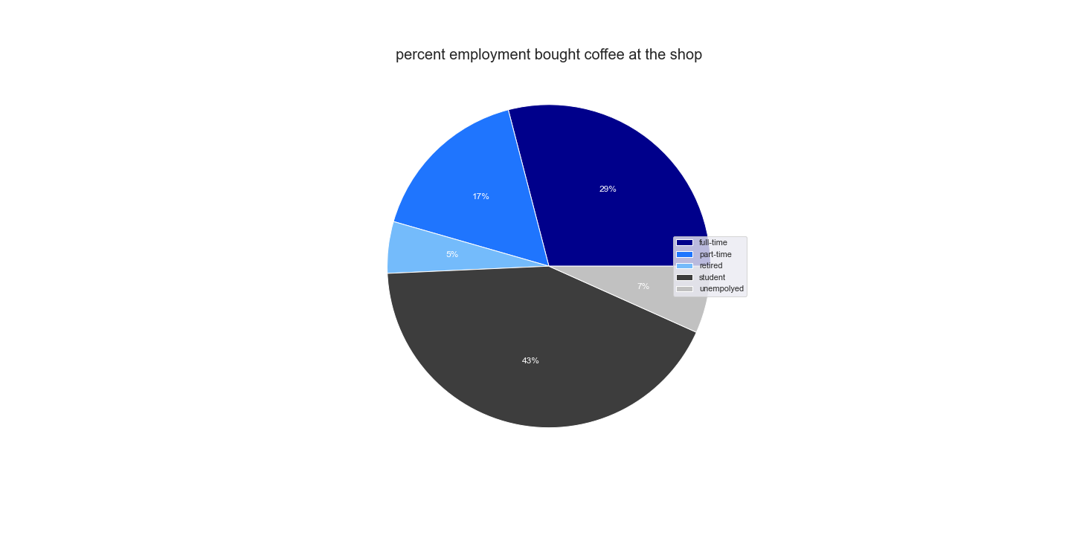
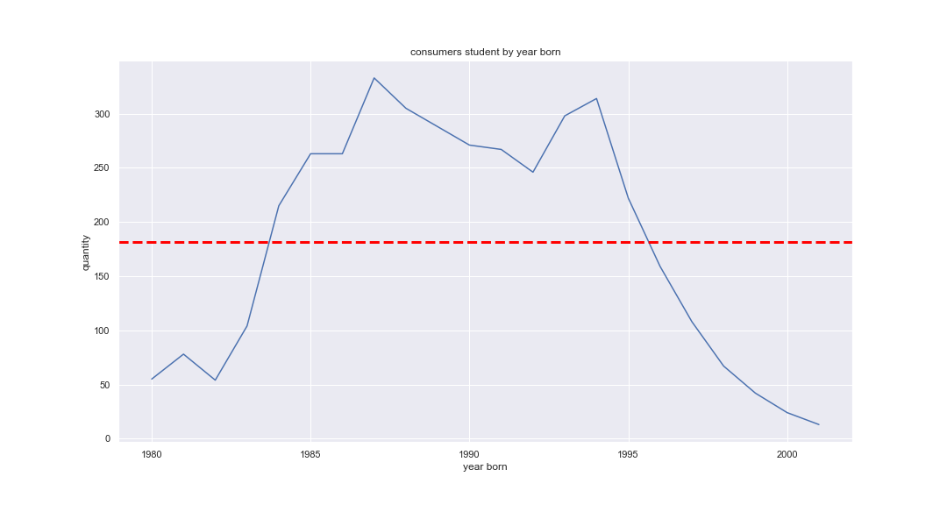
COMMENT:
about 43% of the consumer is students use to buy coffee at shops in the cities. But most students have about between 25 to 40 ages.
Consumers have employment part-time second largest after employment students.

Slide 12
overview comment
marketing strategy failed because not focus on the set of consumers specific. and eliminate the coffee shops in cities that have few consumers. Instead, that focus on cities has consumers bigger.

Slide 13
Thank you
Tran huu an
+84 0901 964 716
TRANHUUAN0202@GMAIL.COM

